Slide 1
Chapter seven
Enterprise Cybersecurity

Slide 2
Chapter outline
Information security in Enterprise
IBM OWASP Top 10 Vulnerabilities
Two-Factor Authentication
Something you know
Something you have
Something you are

Slide 3
Information Security in entrprises

Slide 4
Why do people go cyber attack?
The initiative of attacking may be
for fun
Cyber attack is caused by human in most cases.
Finding the loopholes from the famous websites.
for money / bitcoin
https://en.wikipedia.org/wiki/WannaCry_ransomware_attack
for politic
https://en.wikipedia.org/wiki/Stuxnet
https://en.wikipedia.org/wiki/2007_cyberattacks_on_Estonia

Slide 5
Why security is hard?
Imagine of designing a textbox for people to enter the student number, how to block the illegal inputs?
Legal format: P-12-34-56-7
Negative Goal
Not allow to enter lowercase characters.
Not allow to enter symbols (‘+’, ‘*’, ‘/’, ‘.’, etc.).
Not allow to enter control characters (del, tab, EOL, EOF, ESC, etc.).
Not allow to enter more than 12 characters.
etc.
Positive Goal
Allow to enter ‘p’, ‘-’, and numbers only (or Regular Expression).

Slide 6
Why security is hard? (cont.)
A company has a proxy server to restrict its staff for accessing websites that are not work-related.
Negative Goal (list all the restricted keywords).
Create a back list to hold all the restricted keywords.
gambling, erotic, violence, politic, etc.
The default setting is to allow all websites.
Positive Goal (list all the allowed websites).
Create a white list to hold the allowed websites.
Company official websites, company internal websites, company related partners, etc.
Like using the Internet Explorer in Windows Server platform.
The default setting is not to allow all websites.

Slide 7
Security is a negative goal
File server security (setting the access right for users)
Positive Goal: “Paul Chan can read the salary.txt file”
Ask Paul to check if he can access the file.
Negative Goal: “Other people cannot read the salary.txt file”
Ask everyone to check if he/she cannot access the file.
Must reason about all possible ways in which everyone might get the data
Change the permissions on salary.txt to get access.
Access disk blocks directly.
Read backup copy of salary.txt from Paul’s text editor.
Intercept network packets to the file server that storing the salary.txt file.
etc.
Security is a negative goal or keep having negative thoughts
Want to achieve something despite whatever adversary might do.
White list is obviously easier but it cannot apply to all cases.

Slide 8
Information Security
Enterprise systems (business logic, customer information, transactional information, etc.) are valuable assets.
Those valuable assets must be well protected in the production environment (untrusted network or Internet).
The security strategy of Enterprise information systems is the balance between
Cost
Secure
Ease of use
They are having trade-off when other elements are stronger.
Money can / cannot buy security!?

Slide 9
Investment on securing the Server Room
Double doors assembly, electrical locks, pin, biometric authentication, surveillance, etc.

Slide 10
Information Security Management
Most of the SMEs (Small and Medium-sized Enterprises) have their own “tailor-made” strategies for security.
Others will rely on the ISO (International Organization for Standardization) and IEC (International Electro-technical Commission) industrial standards.
ISO/IEC 7498-2 (year 1989)
BS 7799 (year 1995)
ISO/IEC 17799 (year 2000)
ISO/IEC 27002 (year 2005)
Enterprise systems may perform the Security Assessment by the third party consultants in order to fulfill the ISO requirements before launching their systems and applications.
Provide holistic reviews and assessments on system.
Provide comprehensive tests and solutions to system.
Provide certificates to prove the security level of their systems.

Slide 11
NIST Cybersecurity Framework
National Institute of Standards and Technology (NIST) suggests a cybersecurity framework for people to adopt.
It consists of standards, guidelines, and best practices to manage cybersecurity-related risk.
It’s prioritized, flexible, and cost-effective approach helps to promote the protection and resilience of critical infrastructure and other sectors important to the economy and national security.

Slide 12
NIST Cybersecurity Framework
Identify: develop the organizational understanding to manage cybersecurity risk to systems, assets, data, and capabilities.
Protect: develop and implement the appropriate safeguards to ensure delivery of critical infrastructure services.
Detect: develop and implement the appropriate activities to identify the occurrence of a cybersecurity event.
Respond: develop and implement the appropriate activities to take action regarding a detected cybersecurity event.
Recover: develop and implement the appropriate activities to maintain plans for resilience and to restore any capabilities or services that were impaired due to a cybersecurity event.

Slide 13
Security Checklist for Web Application
Risk Assessment
Authentication
Authorization and Access Control
Session Management
Data and Input Validation
Cross Site Scripting (XSS)
Command Injection Flaws
Buffer Overflows
Error Handling
Logging
Remote Administration
Web Application and Server Configuration

Slide 14
owasp
Open Web Application Security Project
An international organization dedicated to enhancing the security of web applications.
This project publishes a list of the top 10 web application security risks worldwide.
Tools: ModSecurity, Acunetix, IBM AppSecurity, etc.
IBM Security Systems Ethical Hacking team has explained and prepared the suggestion on how to avoid the risks as the following.
IBM OWASP Top 10 Vulnerabilities
https://www.youtube.com/watch?v=zNC2gUJHy-M

Slide 15
IBM OWASP Top 10 Vulnerabilities
Injection
Broken Authentication and Session Management
Cross-site Scripting (XSS)
Insecure Direct Object Reference
Security Misconfiguration
Sensitive Data Exposure
Missing Function Level Access Control
Cross-site Request Forgery (CSRF)
Using Components with known Vulnerabilities: Heartbleed and Shellshock in action
Unvalidated Redirects and Forwards

Slide 16
Top 10 Vulnerabilities
1. Injection
Injection flaws, such as SQL, OS, and LDAP injection occur when untrusted data is sent to an interpreter as part of a command or query.
The attacker’s hostile data can trick the interpreter into executing unintended commands or accessing data without proper authorization.
2. Broken Authentication and Session Management
Application functions related to authentication and session management are often not implemented correctly, allowing attackers to compromise passwords, keys, or session tokens, or to exploit other implementation flaws to assume other users’ identities.

Slide 17
Top 10 Vulnerabilities (cont.)
3. Cross-site Scripting (XSS)
XSS flaws occur whenever an application takes untrusted data and sends it to a web browser without proper validation or escaping.
XSS allows attackers to execute scripts in the victim’s browser which can hijack user sessions, deface web sites, or redirect the user to malicious sites.
4. Insecure Direct Object Reference
A direct object reference occurs when a developer exposes a reference to an internal implementation object, such as a file, directory, or database key.
Without an access control check or other protection, attackers can manipulate these references to access unauthorized data.

Slide 18
Top 10 Vulnerabilities (cont.)
5. Security Misconfiguration
Good security requires having a secure configuration defined and deployed for the application, frameworks, application server, web server, database server, platform, etc.
Secure settings should be defined, implemented, and maintained, as defaults are often insecure, and software should be kept up to date.
6. Sensitive Data Exposure
Sensitive data: credit cards, tax IDs, and authentication credentials must be well protected. Attackers may steal or modify such weakly protected data to conduct credit card fraud, identity theft, or other crimes. Sensitive data deserves extra protection such as encryption, and special precautions when exchanged with the browser.

Slide 19
Top 10 Vulnerabilities (cont.)
7. Missing Function Level Access Control
Web applications verify function level access rights before making that functionality visible. However, they need to perform the same access control checks on the server when each function is accessed.
If requests are not verified, attackers will be able to forge requests in order to access functionality without proper authorization.
8. Cross-site Request Forgery (CSRF)
A CSRF attack forces a logged-on victim’s browser to send a forged HTTP request, including the victim’s session cookie and any other authentication information, to a vulnerable web application.
Attacker can force the victim’s browser to generate requests the vulnerable application thinks are legitimate requests from the victim.

Slide 20
Top 10 Vulnerabilities (cont.)
9.Using Components with known Vulnerabilities
Components (Libraries, frameworks, software modules) are always run with full privileges. If a vulnerable component is exploited, such an attack can facilitate serious data loss or server takeover.
Applications using components with known vulnerabilities may undermine application defenses and enable a range of possible attacks and impacts.
10. Unvalidated Redirects and Forwards
Web applications frequently redirect and forward users to other pages and websites, and use untrusted data to determine the destination pages. Without proper validation, attackers can redirect victims to phishing or malware sites, or to access the unauthorized pages.

Slide 21

We need experts for Cybersecurity
Black hat hacker
For fun, profits, politics, etc.
Threatening the enterprises
White hat hacker
Help enterprises to find potential risks, bugs, etc.
Bug Bounty Program
HackerOne

Slide 22
Developer Point of view
The critical factors to consider when exposing an application to Internet
OWASP is usually a great starting point.
Important factors to consider are
Validation of user data: Ensure they are also validated In Business Layer.
SQL Injection: Never build SQL queries using string concatenation. Use a prepared statement. Even better, use frameworks like Hibernate to handle communication with a database.
XSS-Cross Site Scripting: Ensure you check against an allow list of input characters.
Avoid using old versions of software

Slide 23
Developer Point of view
What are the best practices regarding handling security for a web application?
Best practices are:
Threat Modelling: Do threat modelling and understand the various security threats posed to the application
Static Security Analysis: Use a static security analysis tool like Fortify.
Educate Developers and Testers: Most significant part. Developers and Testers should be aware of the latest security threats.
Dynamic Security Tests: Dynamic security tests done by a professional security testing team should be an essential part of the release cycle. It is preferable to do this as early as possible.

Slide 24
Two-Factor Authentication

Slide 25
Authentication
Enterprise systems must provide secure methods for customers to access their systems on Internet.
They require some mechanisms to identify their customers from the hackers.
Commonly used authentication mechanisms
Two-Factor Authentication / Two-Step Verification
Something you know (knowledge)
Something you have (hardware devices)
Something you are (biometric)

Slide 26
What is two-factor authentication?
Two-factor authentication adds a second level of authentication to an account log-in. When you have to enter only your username and one password, that's considered a single-factor authentication. 2FA requires the user to have two out of three types of credentials before being able to access an account. The three types are:
Something you know, such as a personal identification number (PIN), password or a pattern
Something you have, such as an ATM card, phone, or fob
Something you are, such as a biometric like a fingerprint or voice print

Slide 27
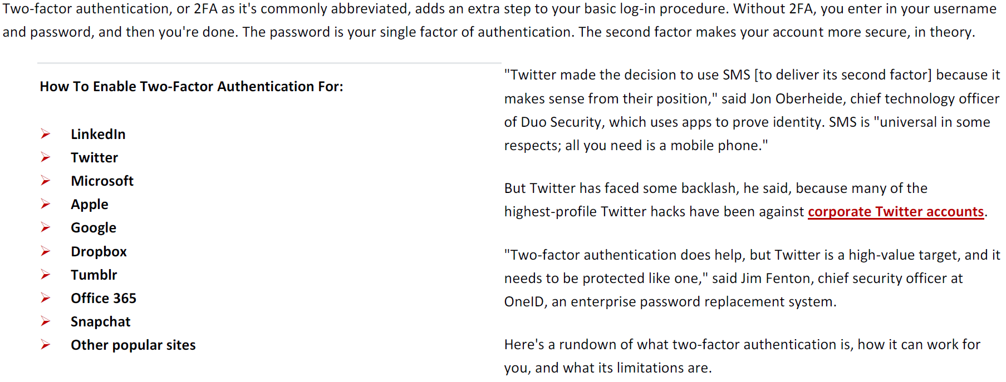
Popular websites are using it

Slide 28
Two-Factor Authentication
Traditional applications require only username and password to login a system (something you know).
2FA requires one more factors(something you have or something you are) for authentication.
Hong Kong Monetary Authority requires online systems to adopt 2FA for high risk transactions.
https://www.hkma.gov.hk/eng/smart-consumers/internet-banking/#two-factor-authentication
Monetary Authority of Macao(AMCM) suggests to adopt multi-factor authentications for high risk transactions.
Circular No. 003/B/2008-DSB/AMCM 5.2(a)
http://www.amcm.gov.mo/files/banking_sector/rules_and_guideline/notices_and_guidelines/en_av_03_2008.pdf

Slide 29
2FA is required for ebanking(Hong Kong)
Internet Banking in HK must
adopt Two-Factor Authentication

Slide 30
2FA required for e-Banking(Macao)
Guideline on Risk Management of e-Banking
To validate the identify of the customer by verifying
What the customer knows: password or personal identification number.
What the customer has: smart card, security token or digital certificate.
What the customer is: fingerprint or iris pattern (biometric characteristic).
The use of single factor authentication is not adequate for
Sensitive communications
High value transactions
Third party transfers or privileged user access
Multi-factor techniques are necessary in those cases unless there are adequate security measures, risk mitigating controls.

Slide 31
Something you know
User account, ID card number, bank account
Unique pattern, check digits verification
Password
Lengthily, frequently change
Word in pictures
Numbers, characters, symbols and words
Knowledge
Define your own questions and answers.
Computer generate questions: mathematic calculation.

Slide 32
Something you have
Token (hardware)
Session key, generate a number for login
Token (software)
Mobile apps to generate session key
Digital Certificates (hardware)
VeriSign, Macao post (e-Signtrust)
Digital Certificates (Software)
One-time digital certificate
Digital Passport and ID card
RFID and smart card
Mobile Phone
Near Field Communication

Slide 33
Token Devices
A password generator device, using a unique algorithm to generate passwords based on different seeds (serial number, time, temperature, humidity, geo-location, etc.).

Slide 34
Bank’s Token
Banks issue their own tokens for customers to access the Internet banks to perform online transactions.
Some issue a password card to find the coordination (A3, G4, etc.) to make a fixed-length password.

Slide 35
Online Payment
Online shops will forward the payment to the bank website for 2FA online transactions.

Slide 36
Digital Certificates
Asymmetric key algorithm (encryption and decryption)
Idea of multiplying two very large prime numbers.
A certificate contains a key pair (public and private key).
Users own the private key and keep in secret.
Users disclose the public key for people to use.
Short life time and need to renew periodically
Digital certificates will be expired since hacker with supercomputer can find the keys eventually (eg. solving the multiplication).

Slide 37
Hardware Devices
Digital certificates, card reader, all-in-one USB stick, etc.
http://www.esigntrust.com/en/hardware.html

Slide 38
Digital Certificates (software)
Since the digital certificates will be expired in 2 or 3 years, renewing the digital certificates are costly to users.
Installing the software plug-in and bringing the hardware devices (reader and certificate) are inconvenient to users.
Therefore, some digital certificates issuers provide one time digital certificate service.
It doesn’t require software (browser plug-in, hardware driver) installation
It doesn’t require hardware devices for operation
Users don’t require to maintain the costly digital certificate
Users don’t require to go through the steps of issuing the digital certificate from issuer for renewal on every 2 or 3 years
The certificates will be used only “once” so it will be meaningless to hacker to find the keys

Slide 39
One-Time Certificate
Digital certificates with very short life-time.
Easy operation steps:
Download from issuer
Import to local PC
Password to access
Ready for online transaction

Slide 40
Near Field Communication (NFC)
Based on radio-frequency identification (RFID).
Many smart phones have already embedded the NFC technology to provide contactless communications.
Samsung, iPhone, Huawei, Mi, etc.
Commercial Usages
Google wallet, Credit Card, Mobile Payment, Ticketing System, Advertisement, Supermarket Ordering, Data Exchange, Octopus, etc.
Security Issues
The information protection is very weak in the earlier version of Google Wallet and Credit card (Visa Paywave).
Hackers can use mobile phones to read the NFC credit card information from a nearby person silently.

Slide 41
Commercial Products

Slide 42
Something you are
Biometric authentication
The identification of humans by their physical characteristics or traits for access control.
Application Examples
Fingerprint as in notebook
Face recognition
Eyeballs recognition
Voice detection
Skeleton tracking can identify game players
Implant RFID tags

Slide 43
Biometrics
Fingerprint, eyeball, face, skeleton, etc.

Slide 44
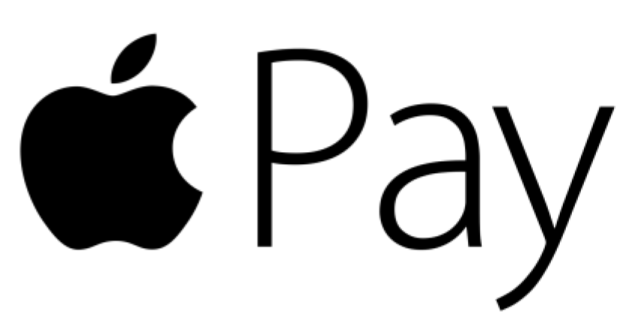
Smart Phone
Embedded fingerprint scanner in a mobile phone.
Online stores can use this device to authenticate their customers for processing sensitive online transactions.
Game servers can use this device to protect players from hackers.

Slide 45
Summary
Security is a negative goal, and it is hard to safeguard all the enterprise information systems.
Enterprises adopt ISO and IEC to establish policies and Code of Practice to protect their valuable assets.
Many governments requires 2FA to be implemented for sensitive and high risk online transactions.

